Slide 1
Getting Science out of eScience
Wilco Hazeleger
www.esciencecenter.nl

Slide 2
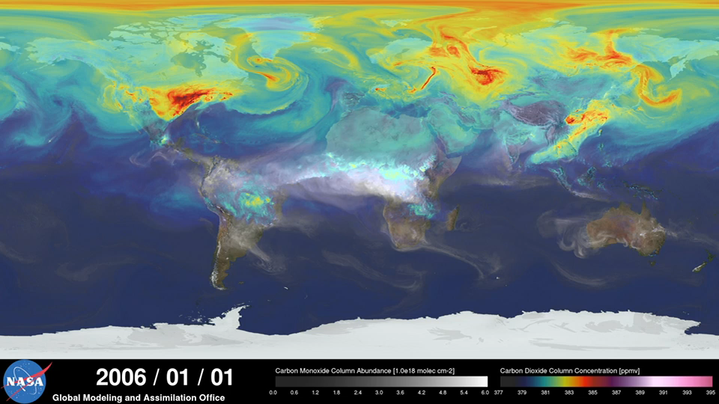

Slide 3
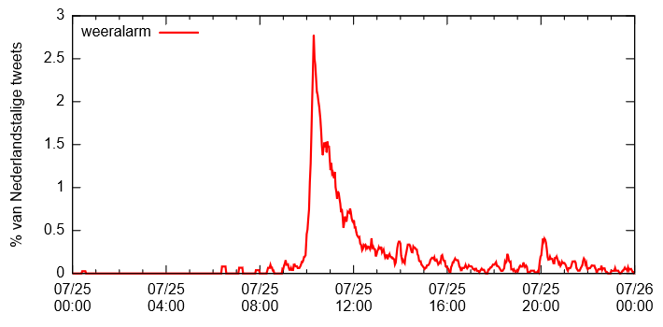

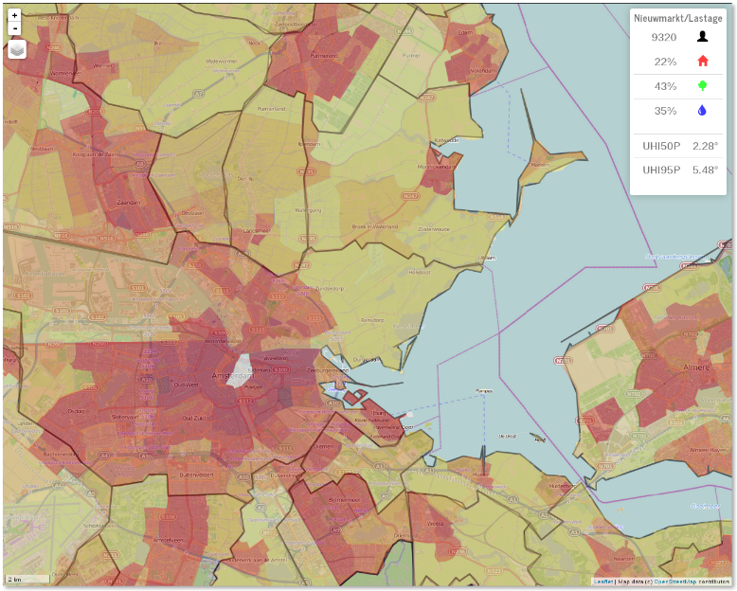
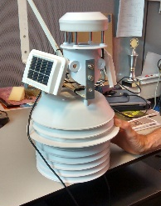
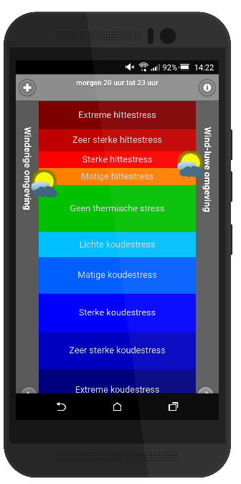
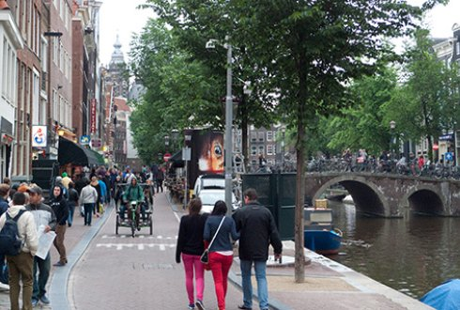
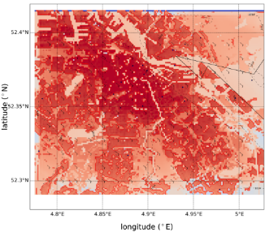

New data sources
https://www.esciencecenter.nl/project/summer-in-the-city

Slide 4
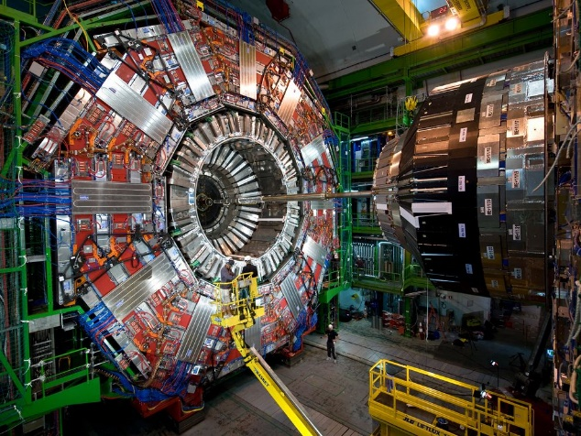
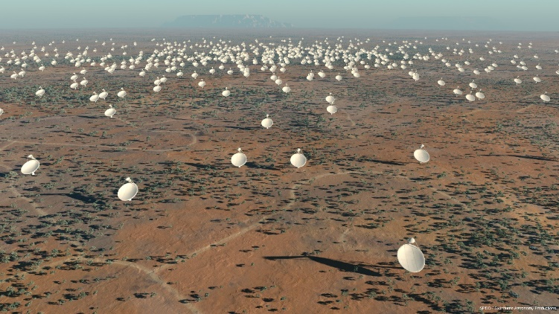
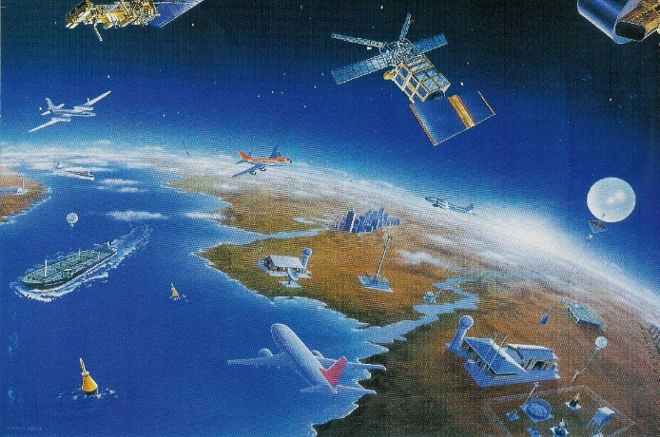
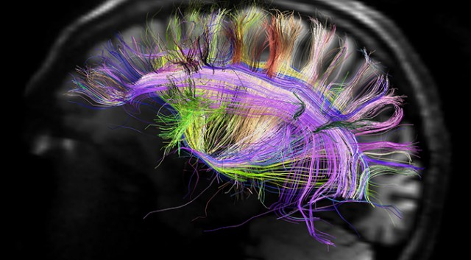
The ‘Big Science’ era

Slide 5
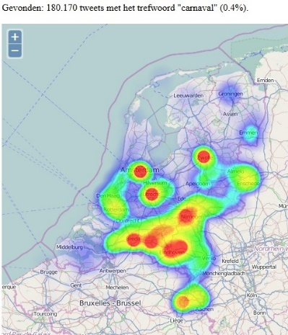
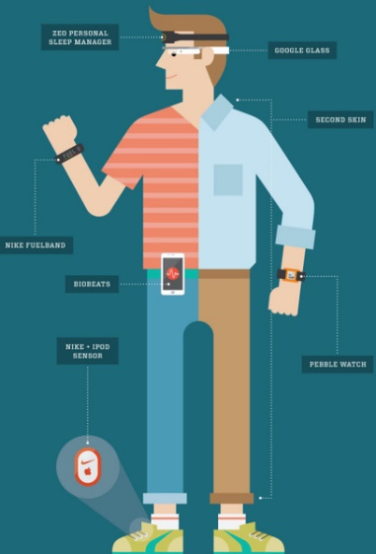
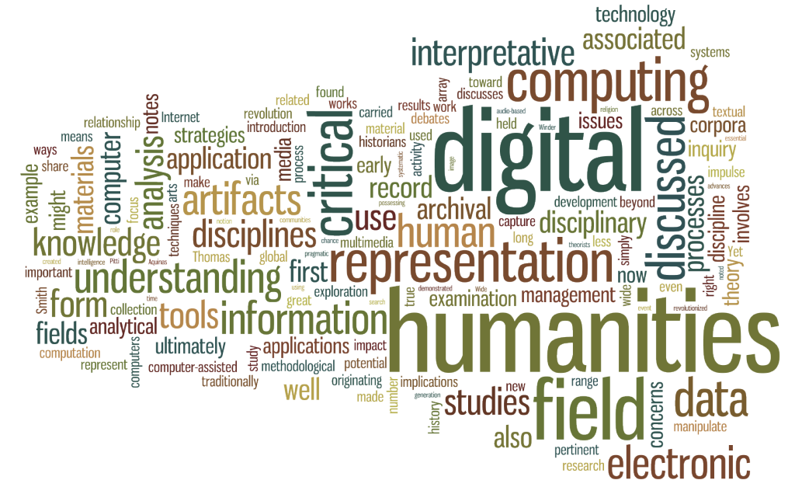

The other ‘Big Data’

Slide 6
Grand challenges
‘Big science’ driven by ‘big societal’ challenges
  Multi- inter-, transdisciplinary research (health & well being, sustainability & energy, society & economy)
  Nearly always a large ICT and data component
Science itself ‘big’ and complex
  Big data (volume, complexity, real time sensor data), computing, analytics
  Interactions between systems and scales

Slide 7
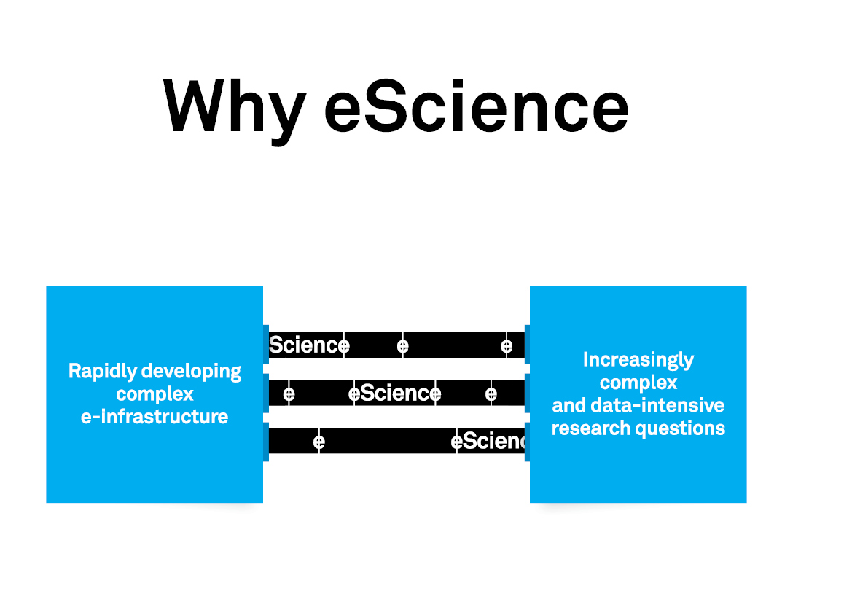

Slide 8
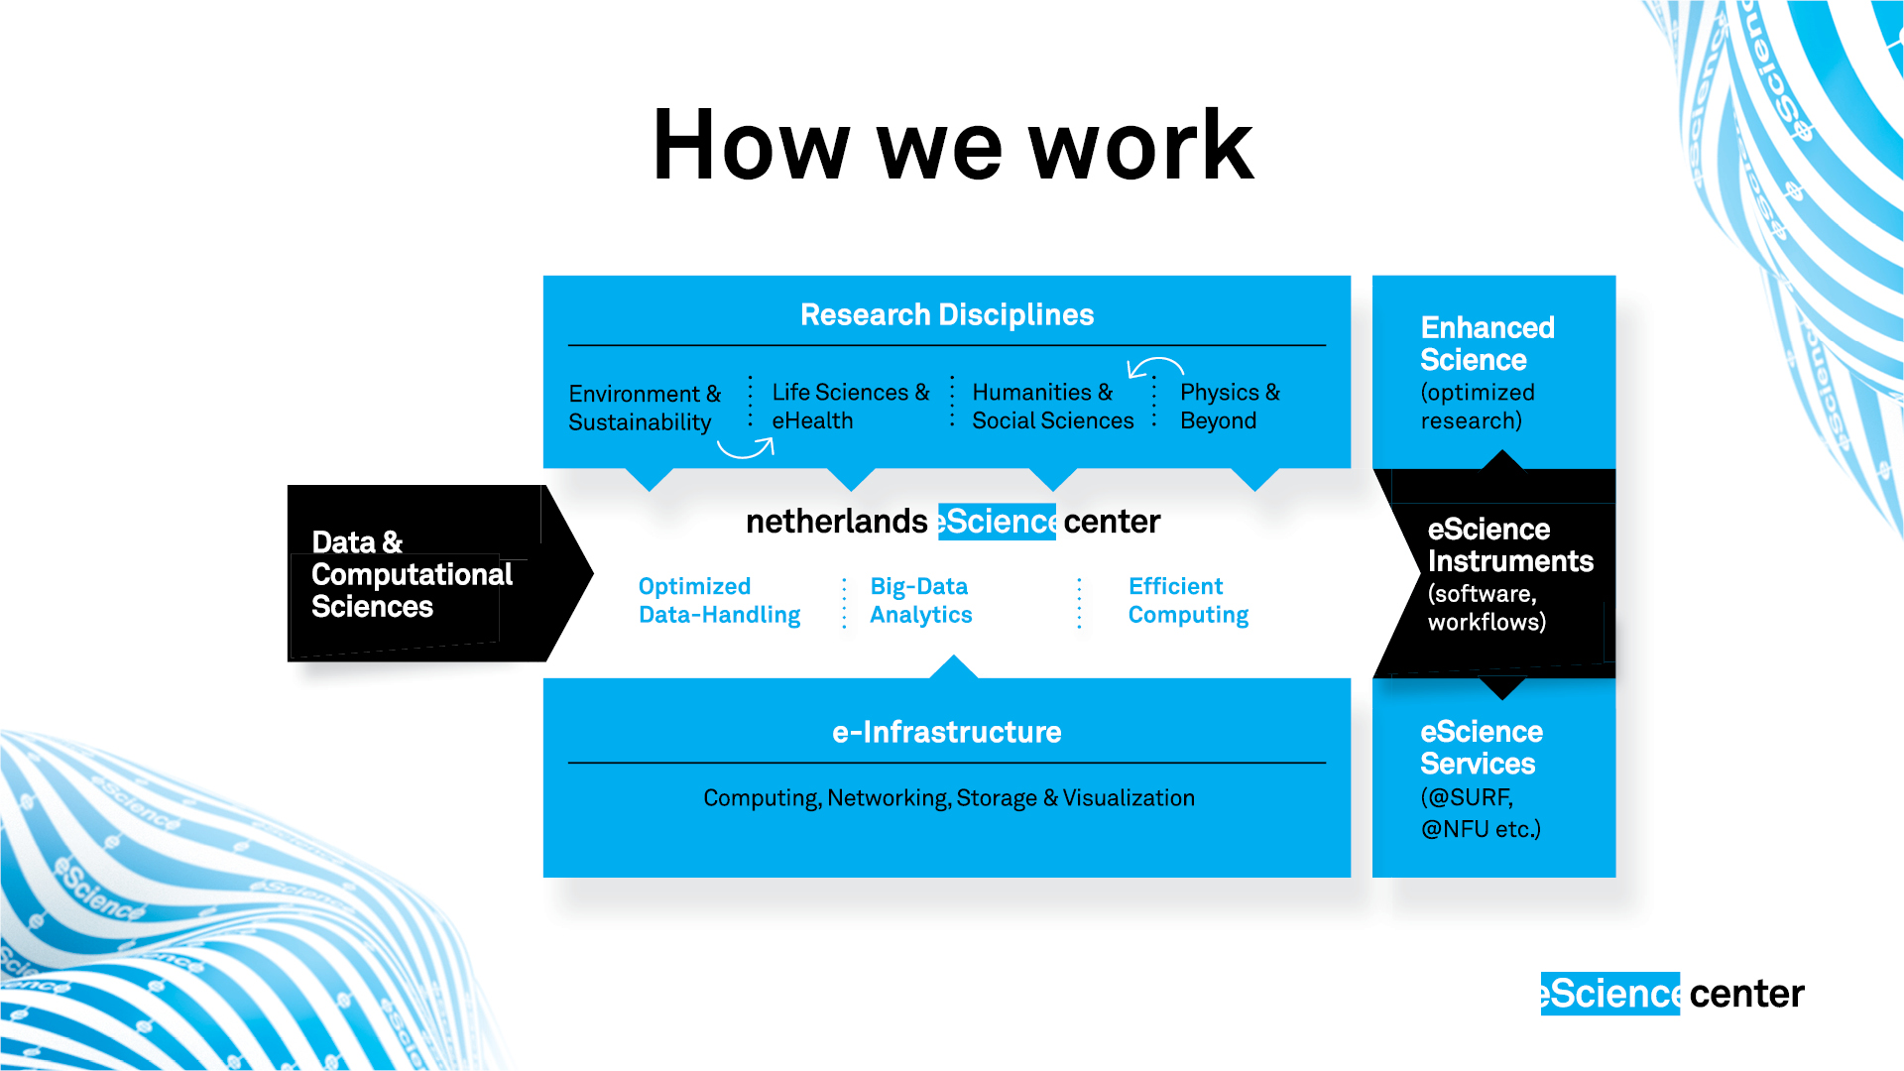

Slide 9
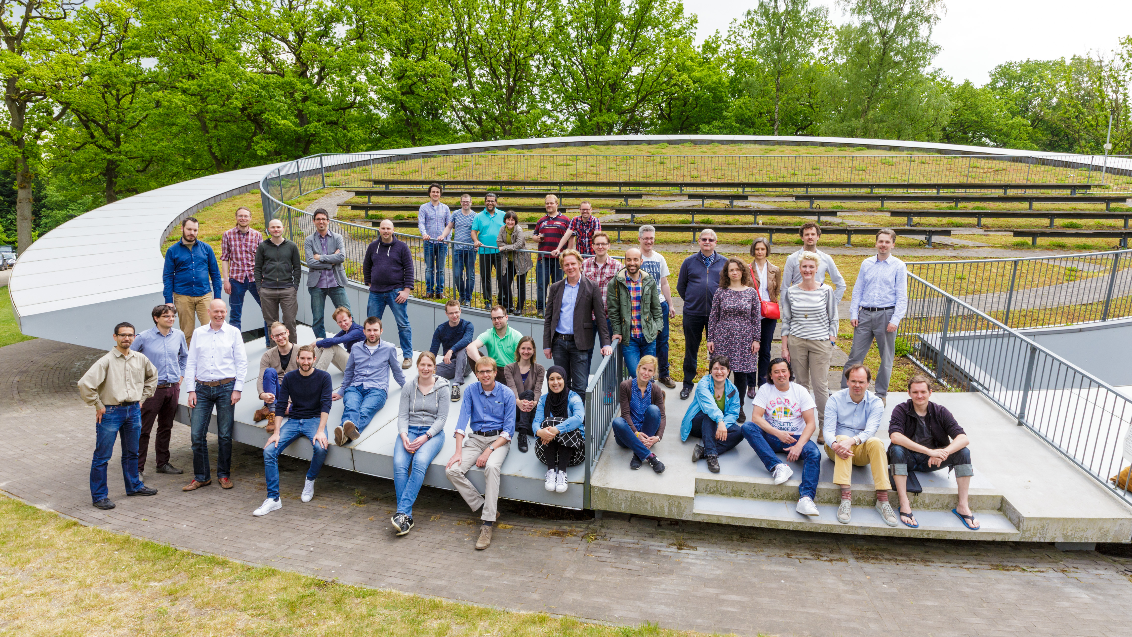
How we work
eScience Research Engineers
Partnership with domain scientist
  All of science
Public private partnerships
(inter)National coordination and advocacy (PLAN-E for Europe)
Generic eScience Technology Platform, eStep (software, open access, knowledge basis)

Slide 10
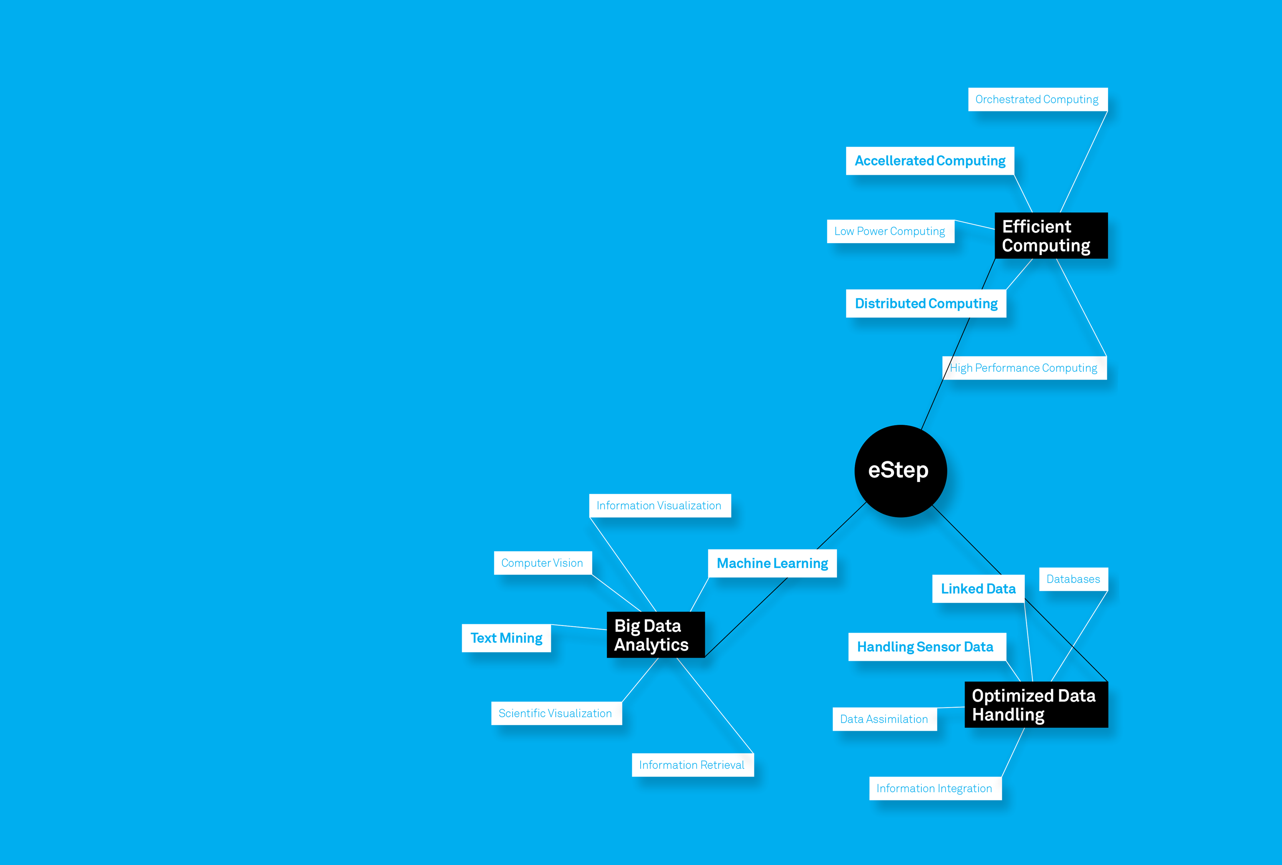
Core eScience
Technologies
eStep.eScienceCenter.nl

Slide 11
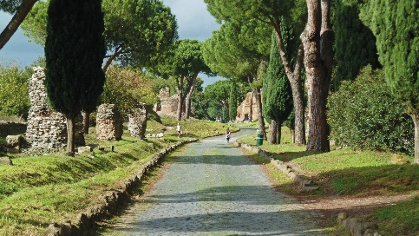
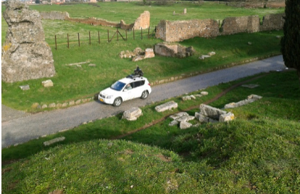
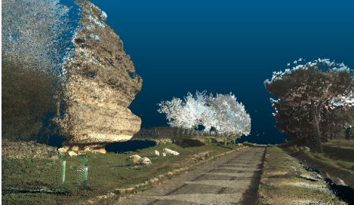
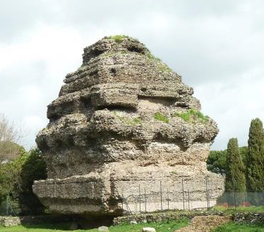
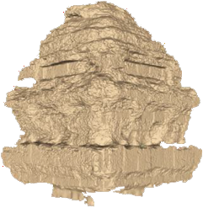
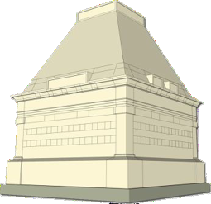
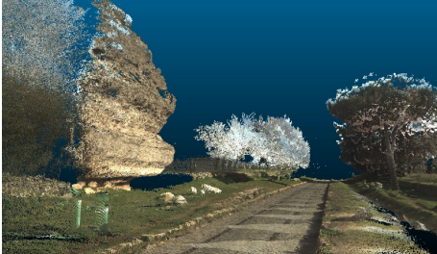
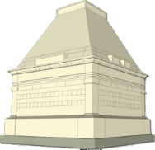

eScience as enabler (4D GIS in archeology)

Slide 12
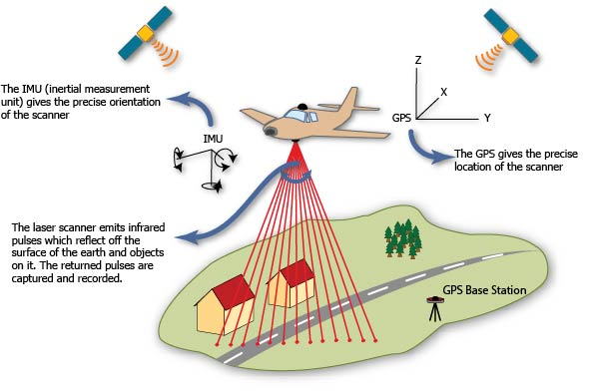

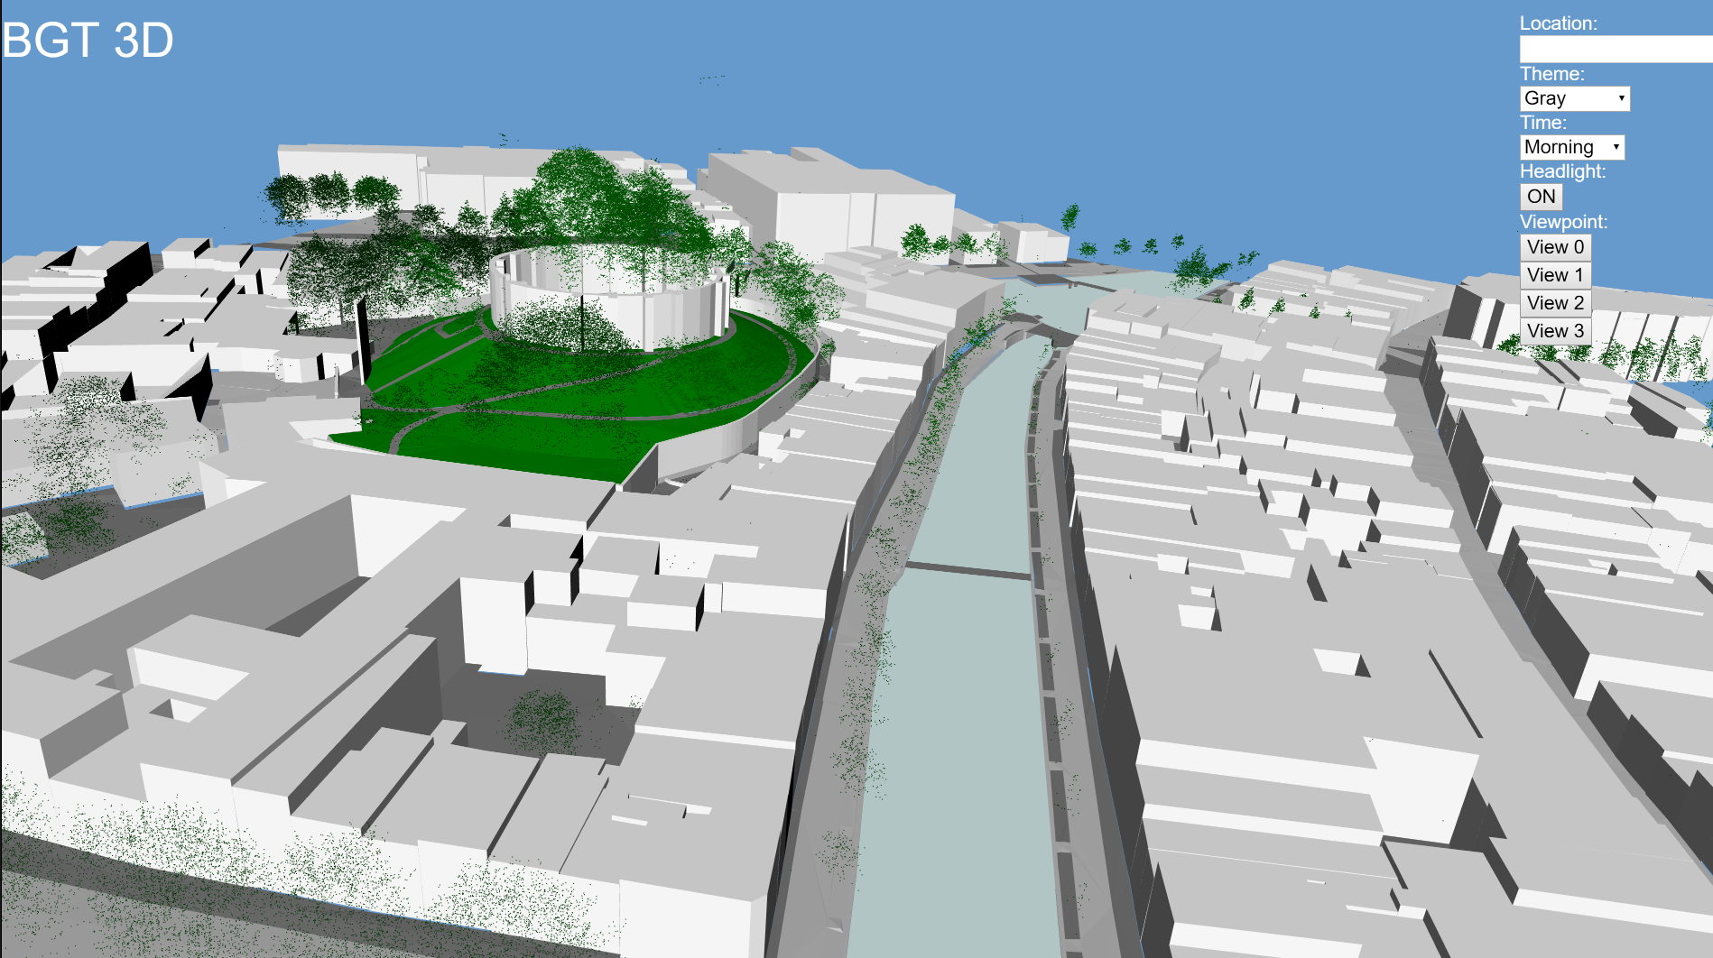
eScience as accelerator: 3D City
10 TB, 64 000 files
First attempt to load
  2 weeks in PostGIS
Notes:
Of course we have plugged everything together to give the user a real system.
When the user interacts with the browser, a request is sent to the DBMS to access a set of tiles from a city, the DBMS loads the required tiles from disk.
The data is filtered, refined using GPU as an accelerator and combined with cadastral data. The result is passed to the web-browser for rendering.

Slide 13
A Spatial Data Management System
New methods data to accelerate access and computation
  18hours to load and prepare the data in-situ data access
  Complex computations with GPU
# times faster
Query number
R. Goncalves et al 2014, 2015, 2016
Notes:
A DBMS contributes for development efficiency. Several data types can coexist under the same conceptual schema (database schema) and applications can interact through a declarative language such as SQL which perfect to define workflows. With SQL problem are declared by the user and then a query plan is compiled to efficiently exploit the underlying hardware.
The solution developed by NLeSC together with CWI DA group showed to be possible to run all the queries where for large and complex polygons the DBMS outperformed lastools[2]. The results are even better when compared with the results of a commercial tool using a full rack server, 96 cores and 1 TB main memory, the results of such commercial system are in [1].
Together with efficient computing team, the data handling team is now looking to ways to improve performance even further. At the moment they are already able to run queries in a GPU. A demo to demonstrate the entire system will be presented in November at ACM SIGsptial in San Francisco[3]

Slide 14
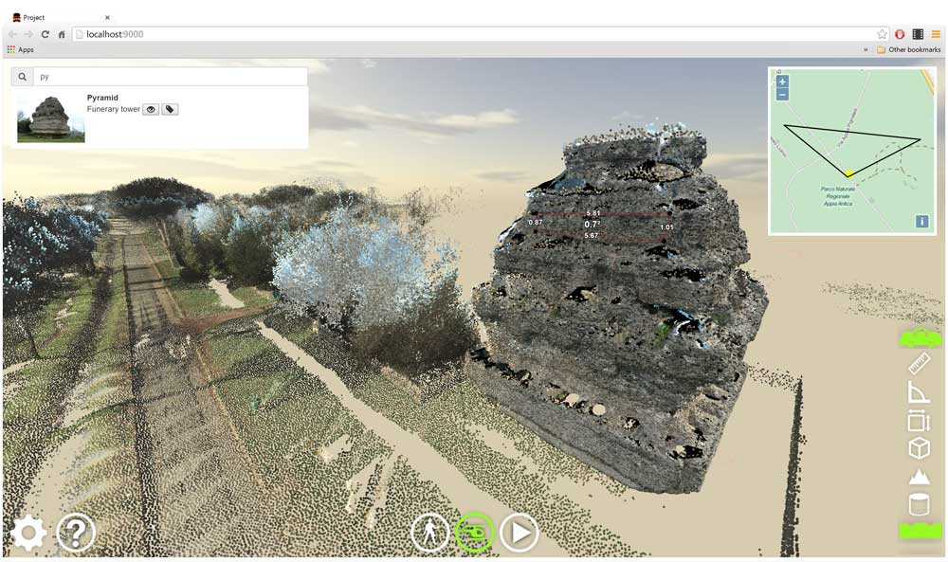
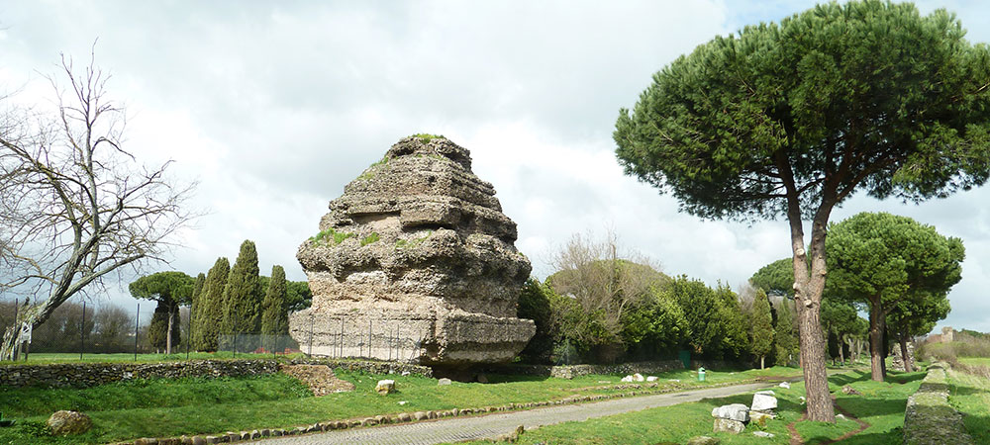

Dealing with data (4D-GIS)

Slide 15
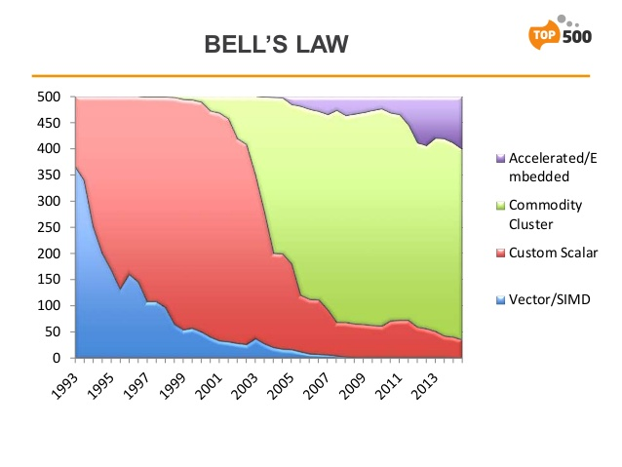
eScience as accelarator

Slide 16
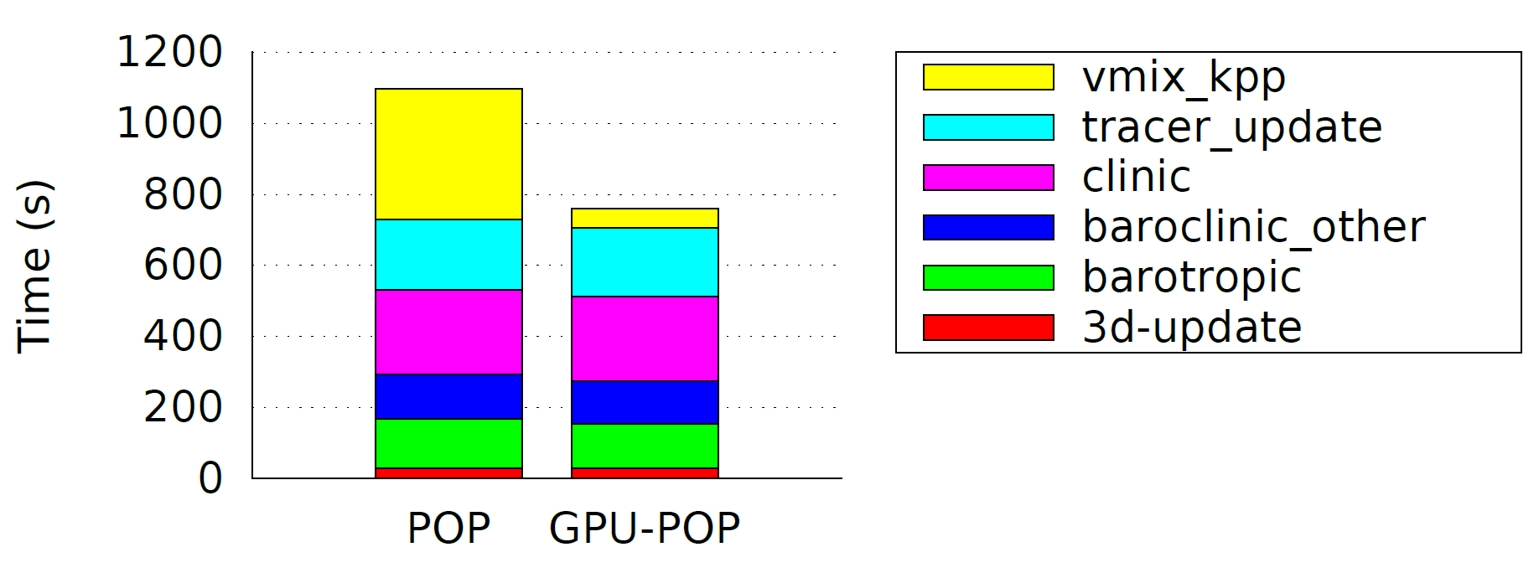
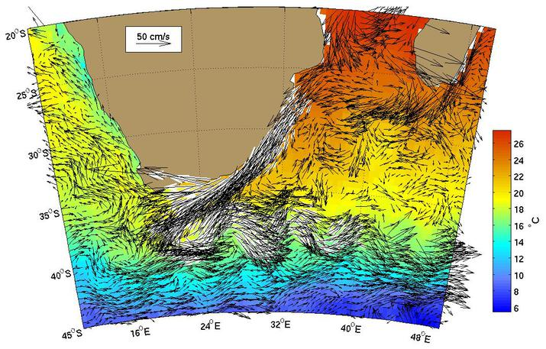
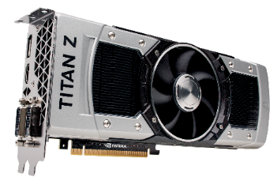

eScience as accelarator

Slide 17
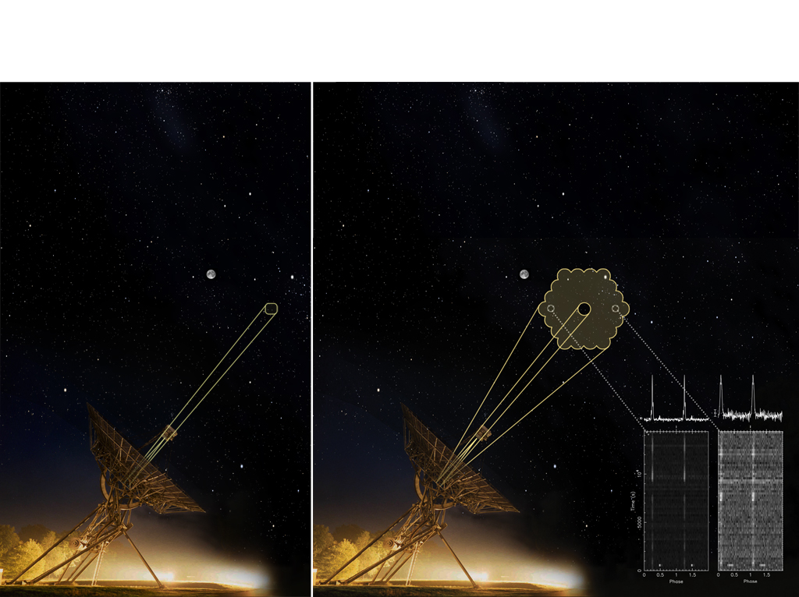
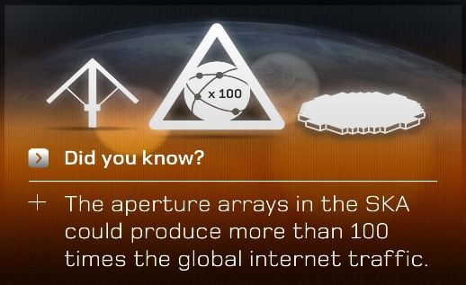
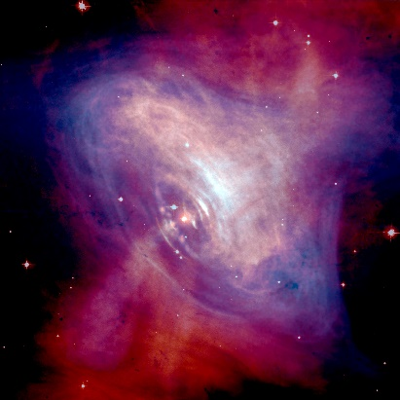
eScience as enabler and accelerator

Slide 18
Accelarating pulsar search pipeline
Dispersion measure and period search compute kernels on different accelarators
Sclocco et al 2015, Finding pulsars in realtime, IEEE eScience

Slide 19
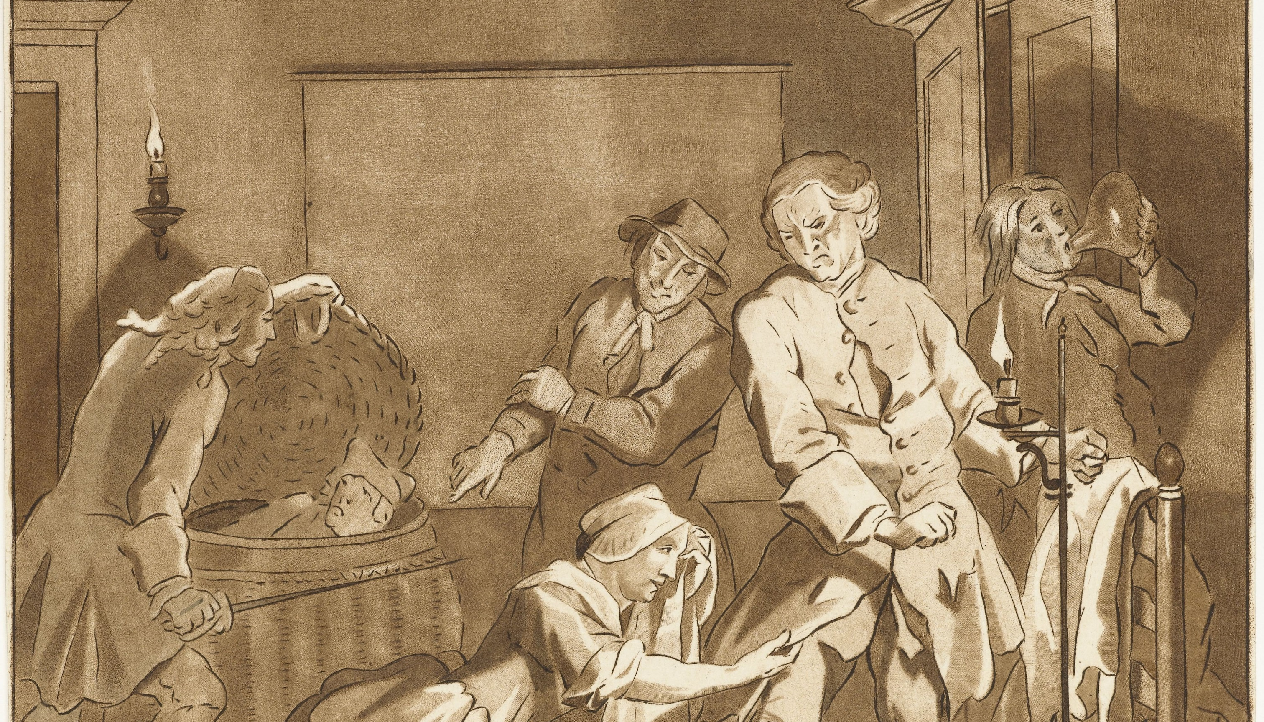

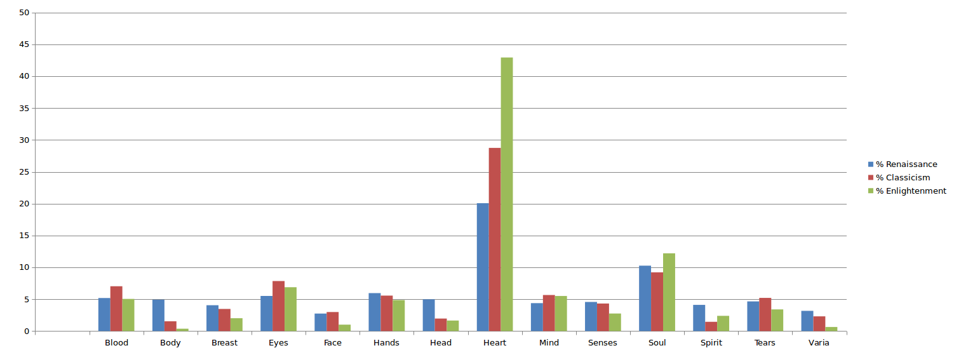

eScience as enabler and accelerator: ‘Embodied’ emotions
vd Zwaan et al, IEEE eScience 2015

Slide 20
eScience as enabler and accelerator: Shifting concepts over time
Data: >600.000 digitized newspaper issues
Multi-dimensional wordvector space using Google’s word2vec (word embeddings)
Semantic and syntactic information representation by geometry (Baroni & Kruszweksi, 2014; Wijaya & Yeniterzi, 2011)

Slide 21
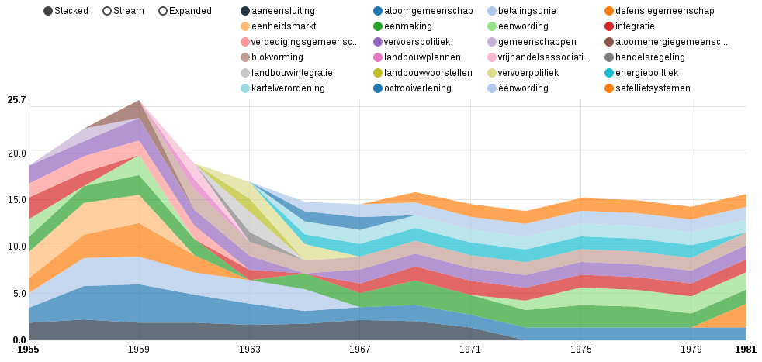
eScience as enabler and accelerator: Shifting concepts over time
Wordvectors (word2vec) on 600000 newspaper issues

Slide 22
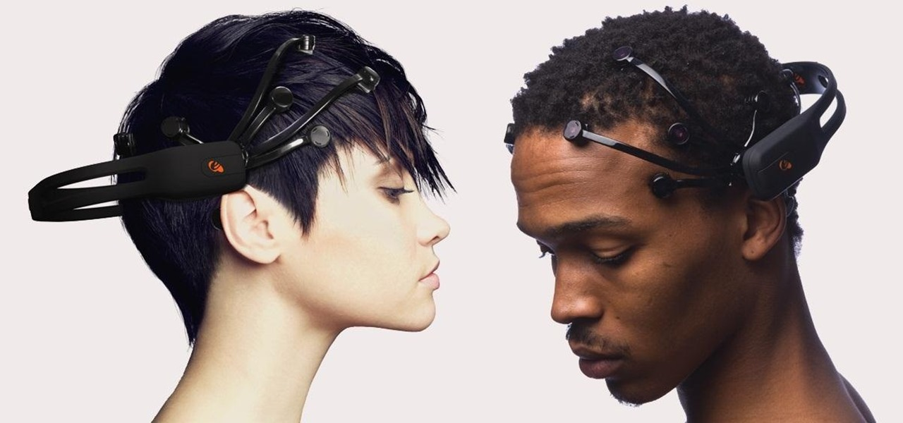
Cheaper EEG for epilepsy
Scaling up machine learning : epilepsy no-epilepsy

Slide 23
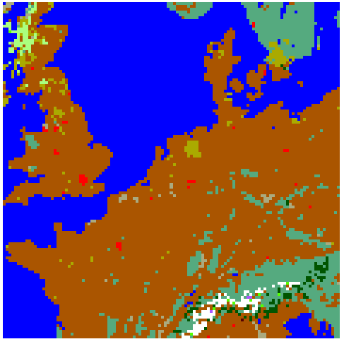
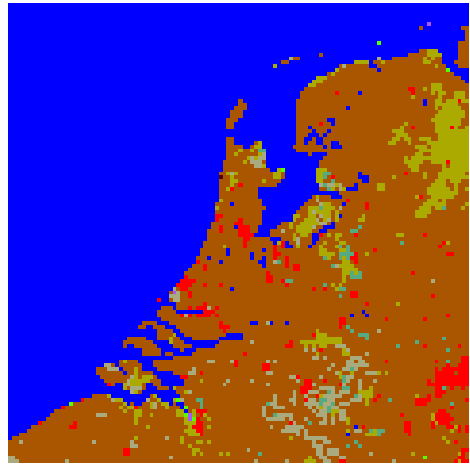
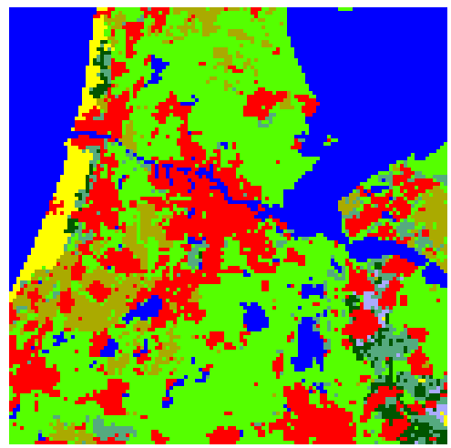
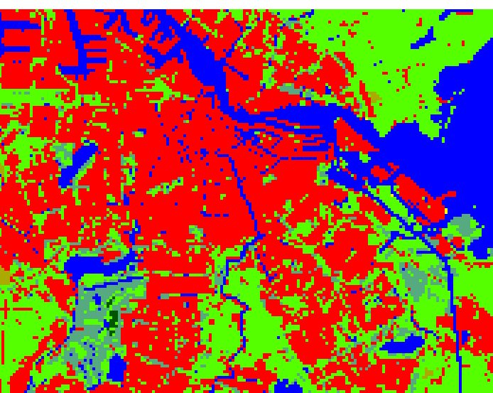
Computing and data challenge
Domain 1: 12.5km
default setup
Domain 2: 2.5km
default setup
Domain 3: 500m
hi-res landuse, ec.
Rijkswaterstaat river temperatures
Domain 4: 100m
Rijkswaterstaat river temperatures,
TOP10NL, satellite imagery, AHN2 (height map), CBS data
Daily forecasts
WRF3.5 + urban module (SLUCM)
48 hour runs, 24 hour spin-up

Slide 24
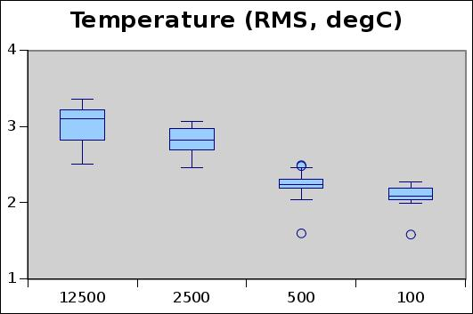
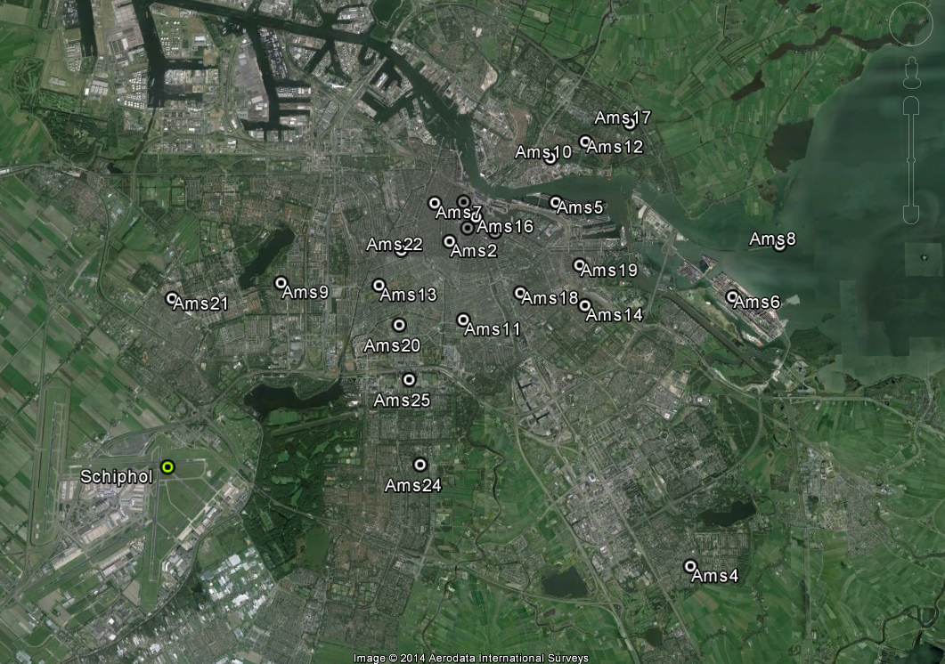
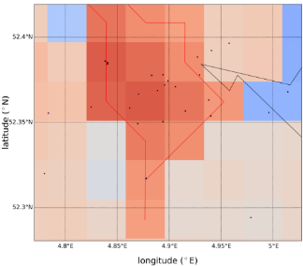
Impact of resolution and land use on weather forecasts (summer 2014)
12,5 km 2,5 km 500 m 100 m

Slide 25
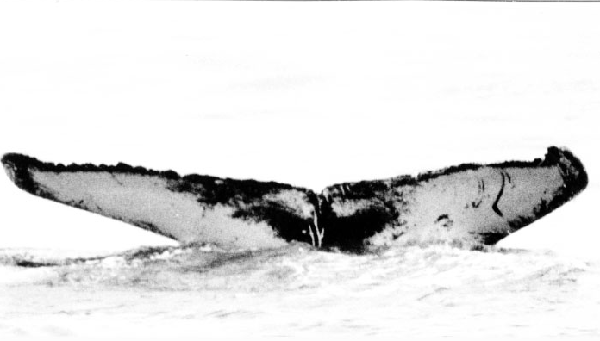
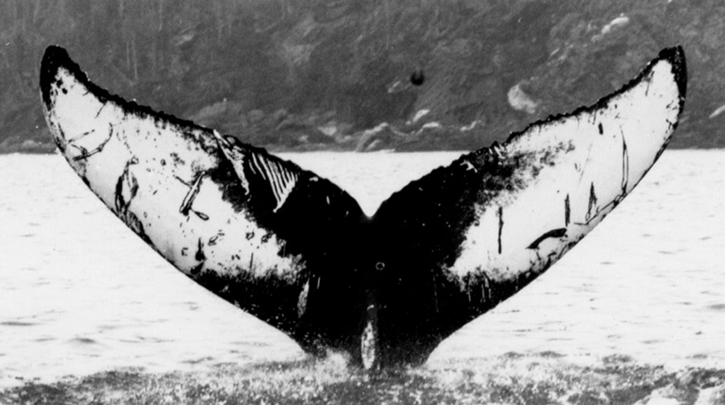


Tracking from different sources
?
✗
✓
✗
Notes:
On this slide: Write down the research question that your project addresses (in your own words, everyone should be able to understand your question).
Explain in 1 minute the problem of your PI, and why he needs you to answer the problem.

Slide 26

Data driven morphological salient regions
Number of correspondences, Nc = # matches in common image part
Repeatability, R = Nc / min # regions in the pair of images <base, transf.>
Ranguelova et al 2016
Notes:
On this slide: Write down in a short sentence (max 10 words!) what the scientific result of this project is/will be. Prefferably illustrate the (expected) scientific result in a picture.
Explain in 1 minute what your PI will be able to do in the future that he can’t do today (thanks to the software you developed).

Slide 27


FAIR dataport for Life Sciences
Transform
Notes:
Linking different datasets is crucial in the candygenes project.
This project is a good example of linking genomic data with phenotypic traits (in order to improve crop)

Slide 28



Real time sensor networks and analytics: crowd management

Slide 29


Slide 30

software.esciencecenter.nl

Slide 31
eScience
  bridges infrastructure, computer/data science and research
  crucially takes a domain science perspective
Common themes
  Data, data, data
  Data stewardship (including FAIR: Findable, Accessible, Interoperable, Re-usable)
  Software quality & sustainability (including generic eScience tools)
  e-Skills → Data Stewards
  Open science: scientific practice and infrastructure (EOSC)
  Incentives and reward systems….

Slide 32



