Slide 1

Funding Research Data Management and related Infrastructures
Knowledge Exchange & Science Europe
Bas Cordewener, Knowledge Exchange
Big Data event, KIT - 5 October 2016, Karlsruhe

Slide 2
Science Europe and Knowledge Exchange
About Science Europe
Science Europe is an association of major European research funding and research performing organisations in 27 countries, established in 2011 to promote the collective interest of its members and to foster collaboration between them.
About Knowledge Exchange
Knowledge Exchange is a collaboration between five (soon six) national organisations supporting the development of ICT infrastructure for higher education and research. KE was established in 2005 to facilitate structural exchange of knowledge, experience, strategies and operations between partners.

Slide 3






Knowledge Exchange
German Research Foundation
Jisc (United Kingdom)
Denmark’s Electronic Research Library
SURF (Netherlands)
CSC – IT Centre for Science (Finland)
Five key national agencies and bodies within Europe responsible for the development of infrastructure and services to support the use ICT within education and research.
Notes:
KE is a small organisation but with sufficient allocated staff within partner organisations and central support
Expert driven with focus on activities with expert involvement. 1 January 2016, CNRS form France will join
Introduction to KE Partner Organisations
Knowledge Exchange is a cooperative of 5 organisations, working together to support the use and development of ICT infrastructure for higher education and research. Although the organisations are very different in size and scope of their work, each has a national responsibility and influence on national policy, operates at cutting edge level of IT development, and can mobilise resources that can make a difference.
We work with expert groups on OA and RD but also address emerging developments that impact open scholarship.

Slide 4

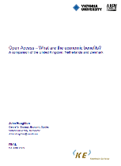
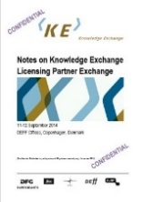

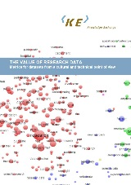

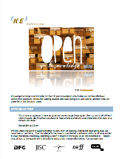
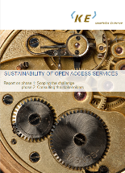
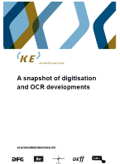

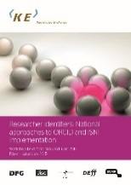

Knowledge Exchange – issues and reports
  Petition to support OA to EC
  Interoperability between Repositories and CRIS
  Website OA success stories
  Multi-national journal licensing pilot
  Response to EC RD ambitions: a Surfboard for Riding the Wave
  Collaborative Research: VREs, Tools, Data
  Persistent Identifier project (URN-NBN, Handle, DOI at one table)
  Guidelines for interoperable Usage Statistics for OpenAIRE
  Discussion paper Open Knowledge (eco-system approach)
  Authority Files (controlled vocabularies)
  Author Identifier Summits (ISNI, ORCID at one table)
  Value, Cost, Pricing, Sharing, Funding of Research Data (Infrastructures)
  Sustainable Business models of OA services
  Research Software Sustainability
  Briefing Paper on Funding RDM and related RDI
Notes:
Over the years we published quite a lot, and there is much more …
Together with Science Europe KE produced a Briefing Paper on todays topic – fuelled by the urgency and importance to increase the quality of research using RDM, via surveys we explored how RDM and the underpinning infrastructure and services are funded.

Slide 5

Why explore Funding RDM & RDI?
Responsible Research Data Management (RDM) is a pillar of quality research.
In practice good RDM requires the support of a well-functioning Research Data Infrastructure (RDI).
One of the challenges the research community is facing is how to fund the management of research data and the required infrastructure.
Notes:
RDM is crucial, and can only be practiced if infrastructure (including services) are in place. Infrastructure and services do not come for free, they need to be funded.
Question is: (how) are they funded?

Slide 6
RESEARCH DATA MANAGEMENT
is defined as the process, services and policies covering how the data used by, or generated from, research is organised, structured, stored, and cared for to ensure both its preservation and re-use.
Notes:
No exclusive definition: but providing a clear outset of what is included

Slide 7
Key conclusions
Stakeholders are well aware that science and scholarship increasingly depend on infrastructures (RDI) supporting sustainable Research Data Management (RDM)
The funding actors, levels and disciplines are not part of a coordinated structure!
Funding of RDI, enabling RDM, comes from
  various sources and institutions
  with different responsibilities
  at local, national or international level
  often influenced by particular disciplinary dimensions
Notes:
Overall the outcomes demonstrate chaos and uncertainty.
Research funding organisations and research performing organisations alike, acknowledge that a data management plan can only work if the required actions can be performed by an available RD infrastructure and services (e.g. storage, ltp)
However, the funding of both RDM and the related infrastructure not coordinated in a proper way

Slide 8
Key conclusions
Consequence of uncoordinated funding: RDI providers have different perspectives on their roles and responsibilities, which is a hindrance for effective coordination
  RFOs and RPOs fund RDI providers to realise an infrastructure that enables RDM, but
  RFOs have no common view on who should be responsible for sustainable funding of RDI
  RPO-funded RDI providers tend to service the their own (funding) organisation
  The resulting RDM services represent (too) many flavours:
  local, national, international and discipline specific
  with different or overlapping beneficiaries
Notes:
Overall the RD infrastructure and services offered are of great variety, originating from very different ideas about the scope of the providers’ role and responsibility. Far from ideal to agree and work on a common stricture!
Imagine how to secure a sustainable RDM solution in such a kaleidoscopic world; imagine how to get such varied offerings together to agree on a coordinated infrastructure. Challenge is to coordinate organisation that themselves are not coordinated or coordinated in different ways.

Slide 9
Key conclusions
Specifics for RDM and budget scope for required RDI are usually not clearly defined as part of standard research funding.
Let alone that specific RDM requirements at different phases in research process/data life cycle are recognised
It has been known for a long time: costs and funding for RDM/RDI need to be better defined and coordinated
The KE & SE survey flags that the problem persists!
Notes:
The standard funding available is usually not specifically aimed at RDM, let alone at establishing the required DR Infrastructure
This is not a new finding! For many years all agree that RDM and RDI require targeted and coordinated funding,

Slide 10
Key conclusions
Lack of a common view on roles of actors with regards to RDM and RDI disables funding mechanisms to respond to shifting demands (management, preservation and sharing of data across borders, disciplines and organisations
Sustainability of RDI/RDM is at risk – if funding remains mainly project based. Need for sustainable business models and responsibility frameworks need to be developed.
– coordinated approach
– especially national and European level of funding RDI!
Main sources for funding RDM/RDI are government and (depending on discipline) private sector: responsibilities and acknowledgement of common and specific ambitions need to be balanced
Notes:
The existing landscape of uncoordinated, unconnected actors make it impossible to use funding (money, usually the means to get things done) to respond to emerging needs or find common (efficient and effective) solutions. Developments such as multi-disciplinary research, increased number of data, open sharing of data, are not met with solutions!
Funding being project based (as is still the way research is funded) ignores that issues around management of research data often occur after the research project is completed. What to do with the data, who is responsible, how to find and share in the long run). How to keep a infrastructure intact to allow for re-use?
National and European funders are in a position that they could address the issue and work on a coordination framework.
In some disciplines private funding is significant – and both private as well as public research needs good RDI supporting RDM – so all th more reason to bring them together!

Slide 11
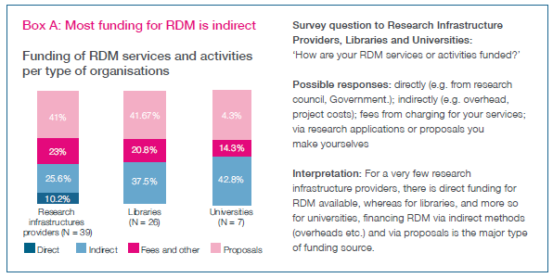
Indirect funding is the norm ☹
Notes:
Indirect funding of course means that unknown parts of unknown grants may have been used.
Funding is not objective oriented, may not be applied to urgent RDM and RDI issues.

Slide 12
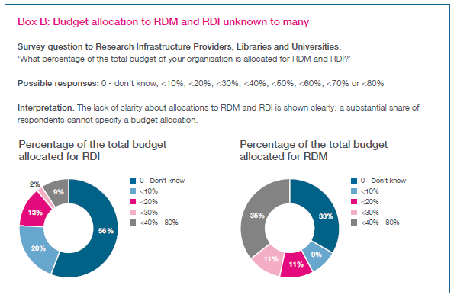
‘I don’t know’ is the most frequent answer ☹
Notes:
I don’t know is not an encouraging answer when talking about the funding of something all agree is crucial to increase the quality of research.

Slide 13

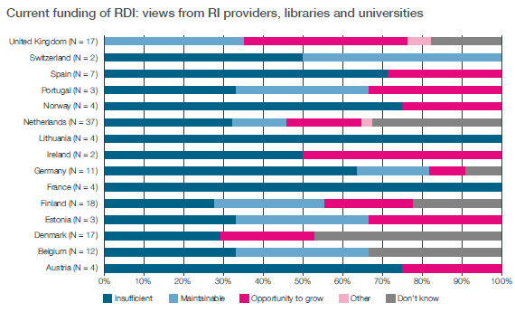
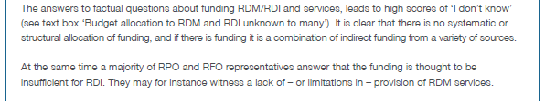
‘I don’t know but I think it’s not enough’ ☹
Notes:
Lots of ‘I don’t knows’ combined with ‘It is insufficient’ illustrates a serious problem.
(Explanation why UK stands out is under investigation)

Slide 14
To solve a problem, cut it in pieces ☺
Challenges related to ‘who’ is funding ‘what’ re RDM and RDI
Funding of RDM: the variety of and mismatch between various funders
Budget Allocation to RDM and RDI: no clarity about value of archived reusable data
Which data should be preserved and for how long
The role and responsibilities of national and European funders
Notes:
This can of course be analysed and mapped, and suggestions for solutions can be proposed to stakeholders
Of course on the other end, the researcher community should make more effort to estimate and validate what the value is that is at stake by doing good RDM or not. Only with such information available, hard claims can be made for required (direct) funding.
An existing problem, but it is worthwhile to formulate for each research project, define what data need to be preserved (and for how long), and what data can be discarded.
Of course part of an ever ongoing discussion – alignment between EU and national funding, but it needs to be done: who is responsible for what part of (sustainable) infrastructure that enables good RDM

Slide 15
To solve a problem, cut it in pieces ☺
Phases of the research cycle present distinct RDM & RDI challenges
Actual research stage: researcher in charge/responsible, budgeted costs should be covered by research grant
Immediately after the research stage: deposit of data according to agreed DMP: costs are not yet/should be covered by research grant – responsibilities depend on RDM policies
Keeping Data available (for replication, validity) costs and responsibility usually with RPO, but after some time the reasons to keep data available is no longer theirs
Continued Preservation There are costs, but who will gain? Open Data principles vs profitability model.
Notes:
Data in different phases of the life cycle may need different types of RDM, in the interest of different stakeholders – as the ownership and value of the data per phase is different.
This is another approach that can be taken to identify where (for what phase in the data/research life cycle) direct funding of RDM/RDI is needed, and identify who should feel responsible for funding RDM/RDI in that particular stage.

Slide 16
Easily said by KE, what will they do ?
Work on Open Scholarship challenges
aspects/hurdles → RLC phases ↓ | Financial hurdles | Organisational hurdles | Technical hurdles | Legal hurdles | Cultural and social hurdles | Incentives and rewards | Career and Training
Ideas |  |  |  |  | Open Knowledge paper
Discovery |  | Authority Files
Planning
…
Apply for Grant
…
Project | Surf Board for Riding The Wave |  |  |  |  | Surf Board for Riding The Wave
Experiment
Data production
Data management | Funding RDM briefing |  |  |  |  |  | RDM Training & Skills work
Data analysis/software | Research Software Sustainability report |  | Research Tools use Cases |  | Research Tools use Cases
Writing
Publication
Open Access | OA sustainability index OA Policy Dependency work |  |  | OA sustainability index
Closed Access
Data sharing | The Value of Research Data Metrics Making Data Count |  |  |  | Motivations & Incentives report The Value of Research Data Metrics Making Data Count Open Knowledge paper
Preservation/findability/referencing | Price of keeping knowledge | National implementations of ORCID & ISNI Authority Files
Dissemination
Digitisation |  | Snapshot Digitisation
Notes:
KE will focus on Open Scholarship using a framework as shown (this is a working model, not yet finalised)
On the vertical axis the Research Life Cycle (RLC) phases, on the horizontal axis the challenges to being Open.
All together this represents the Open Scholarship arena, that KE wishes to focus on.
As a follow-up to the Briefing Paper presented just now, KE will focus on the financial issues in each of the RLCs

Slide 17
Big Data at risk?
The survey represents all types RFOs, RPOs and RDI providers – including established or upcoming Big Data producing disciplines
The lack of coordination in funding RDM and related infrastructures illustrates lack of coordination regarding funding aspects related to all Research Data, such as governance, security, preservation, accessibility
Stakeholders (not just funders) with an interest in Research, including Big Data, should be aware that they are part of the problem if they do not enter into coordinative collaboration with one another.
Notes:
The theme of this event is Big Data –
The outcomes of the survey are based on responding stakeholders, including those that fund, produce or process Big Data.
The survey looked mainly at the funding of RDM and related infrastructures. It is not hard to imagine that in all other aspects, such as governance, security, preservation, accessibility, the lack of coordination in dealing with data, Big Data, will be as bad.
The start of a solution is to be open, and explore and analyse the issues and engage in coordinative agreements.

Slide 18

Find the full report at: http://goo.gl/dqt5z5
Questions are very welcome!
More information:
www.knowledge-exchange.info
s.james@jisc.ac.uk
Continue the conversation:
Bas.Cordewener@jisc.ac.uk

